Slide 1

Reinforcement Learning for Environment & Agent
Comprehensive Technical Analysis of Monte Carlo & TD Learning, Policy Gradients, Advanced Policy Optimization (PPO/TRPO/DDPG), MBPO, and Industrial Applications
Student Name K. Bala Murali
Register Number 192472010
Course Code & Title MLA0301 - Reinforcement Learning
Assessment Tool CO4-AT1 - Technical Presentation
K. Bala Murali
192472010
MLA0301 - Reinforcement Learning
CO4-AT1 - Technical Presentation

Slide 2







Executive Agenda & Questions Selected
1. MC & TD Learning (Q2)
2. Policy-Based RL (Q5)
3. Policy Optimization (Q7)
4. MBPO & Planning (Q9)
Monte Carlo prediction & control, TD(0), SARSA, Q-learning, sample efficiency, and experimental evaluation.
Vanilla Policy Gradient, REINFORCE algorithm, stochastic policy search, robotics, and self-driving systems.
Sampling-based planning, model-based data generation, value-equivalence, and rollout optimization.
PPO, TRPO, DDPG, clipped objectives, trust regions, convergence bounds, and stability benchmarks.

Slide 3

Monte Carlo Methods & Temporal-Difference Learning
Comparative investigation of model-free prediction and control algorithms across episodic and continuous horizons.

Slide 4

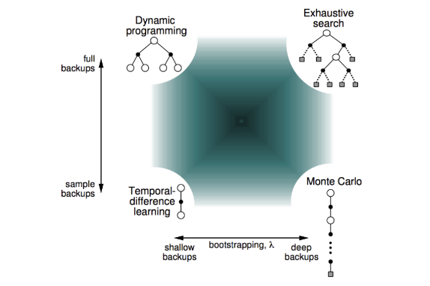
Monte Carlo vs. TD(0), SARSA & Q-Learning
Temporal Difference Error
Monte Carlo: Learns directly from complete episodes ( ); unbiased but high variance.
SARSA (On-Policy): Updates using action chosen by current policy.
Q-Learning (Off-Policy): Bootstraps using maximum target action .

Slide 5

Sample Efficiency & Experimental Performance
Algorithm | Sampling Strategy | Bootstrapping | Variance vs Bias | Convergence Rate
Monte Carlo (MC) | Episodic Full-Rollout | No (Pure Return G t ) | High Variance / Zero Bias | Slow (Requires complete trajectories)
TD(0) Prediction | Step-by-Step Online | Yes (1-Step Estimate) | Low Variance / Medium Bias | Fast online learning
SARSA | On-Policy ( S , A , R , S ′ , A ′ ) | Yes | Moderate Variance & Bias | Safe trajectory convergence
Q-Learning | Off-Policy Greedy Target | Yes | Low Variance / Overestimation Bias | High sample efficiency

Slide 6

Policy-Based Reinforcement Learning
Direct policy optimization in continuous action spaces: REINFORCE, Policy Gradients, and Autonomous Systems.

Slide 7


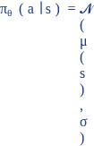
Policy Gradient Theorem & REINFORCE Algorithm
Policy Gradient Objective
Continuous Control: Parameterizes actions directly via Gaussian distributions .
REINFORCE: Uses empirical return as unbiased estimator of .
Stochastic Search: Ensures smooth exploration over high-dimensional robotic joints.

Slide 8





Applications in Robotics & Autonomous Driving
Continuous Vehicle Control
Robotic Manipulation
Stochastic Policy Exploration
Direct output of smooth steering angles, throttle percentages, and braking torque without discretization artifacts.
Multi-joint trajectory generation for precision arm assembly, torque control, and dynamic obstacle avoidance.
Adaptive variance tuning allows robots to explore safely around high-risk physical operational boundaries.

Slide 9

Advanced Policy Optimization Techniques
Stabilizing deep policy learning: Proximal Policy Optimization (PPO), TRPO, and Deep Deterministic Policy Gradient (DDPG).

Slide 10

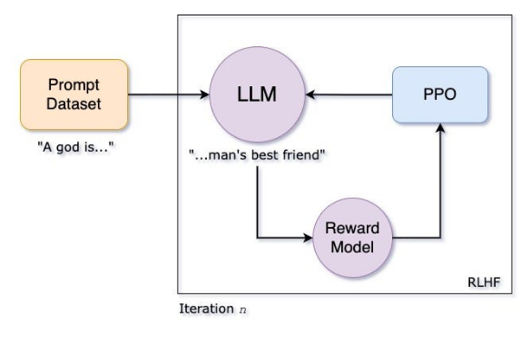
PPO, TRPO & DDPG Mathematical Mechanics
PPO Clipped Objective Equation
TRPO: Enforces hard KL-divergence trust region constraint via second-order Hessian computation.
PPO: Replaces second-order optimization with first-order clipped surrogate objective for high efficiency.
DDPG: Off-policy actor-critic algorithm utilizing deterministic policy gradient with replay buffers.

Slide 11

Convergence, Stability & Efficiency Benchmark
Technique | Optimization Type | Sample Efficiency | Monotonic Convergence | Implementation Complexity
TRPO | Second-Order Conjugate Gradient | Moderate (On-Policy) | Guaranteed via KL Bound | High (Hessian Vector Products)
PPO | First-Order Clipped SGD / Adam | High (Multiple Epoch Rollouts) | Empirically Stable | Low / Highly Robust
DDPG | Off-Policy Deterministic Gradient | Very High (Replay Buffer) | Prone to Hyperparameter Sensitivity | Moderate (Target Actor/Critic Networks)

Slide 12

Sampling-Based Planning & MBPO
Sampling-Based Planning & Model-Based Optimization
Accelerating learning curves using dynamic model rollouts, value-equivalence prediction, and MBPO frameworks.

Slide 13
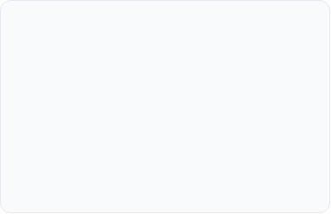

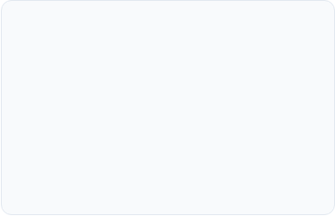

MBPO Architecture & Model Data Generation
Ensemble Dynamics Modeling
Short Model Rollouts
Value-Equivalence Prediction
Trains an ensemble of bootstrap neural network transition models to quantify and reduce epistemic model uncertainty.
Generates short-horizon synthetic rollouts ( ) starting from real environment states, preventing compounding prediction errors.
Optimizes dynamics models specifically for target value estimation accuracy rather than pixel-level or state-space reconstruction precision.

Slide 14

Industrial Applications of Advanced Reinforcement Learning
Deploying Value-Based, Policy-Based, and Model-Based RL in Smart Grids, Autonomous Vehicles, Healthcare, and Finance.

Slide 15
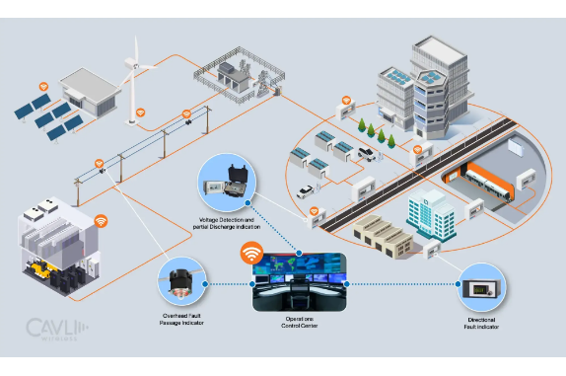
Cross-Industry Deployment & Paradigm Matrix
Smart Grid Energy: Dynamic load balancing and battery storage optimization via PPO/DQN.
Algorithmic Trading: Portfolio management and order execution using continuous policy optimization.
Healthcare Decision Support: Sepsis treatment dosing strategies using dynamic offline RL.

Slide 16

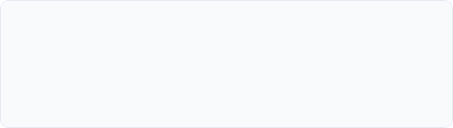
Questions & Answers
Thank you for your attention during this technical evaluation presentation.
PRESENTER DETAILS
K. Bala Murali
Register No: 192472010 | Course: MLA0301 (Reinforcement Learning)
SIMATS Engineering • Department of Computer Science & Engineering

Slide 17




Image Sources
https://richard-warren.github.io/images/blog/rl_imgs/rl_bigpicture.PNG
Source: richard-warren.github.io
https://www.mdpi.com/applsci/applsci-15-01323/article_deploy/html/images/applsci-15-01323-g001.png
Source: www.mdpi.com
https://miro.medium.com/1*jDUO1swpIVqFc4BF3cj1Jg.jpeg
Source: medium.com
https://d8wojkg2185gh.cloudfront.net/strapi/smart_grid1_546d9acd24.webp
Source: www.cavliwireless.com

